Slide 1

Secure Iot Network and Smart buildings
WINP4

Slide 2




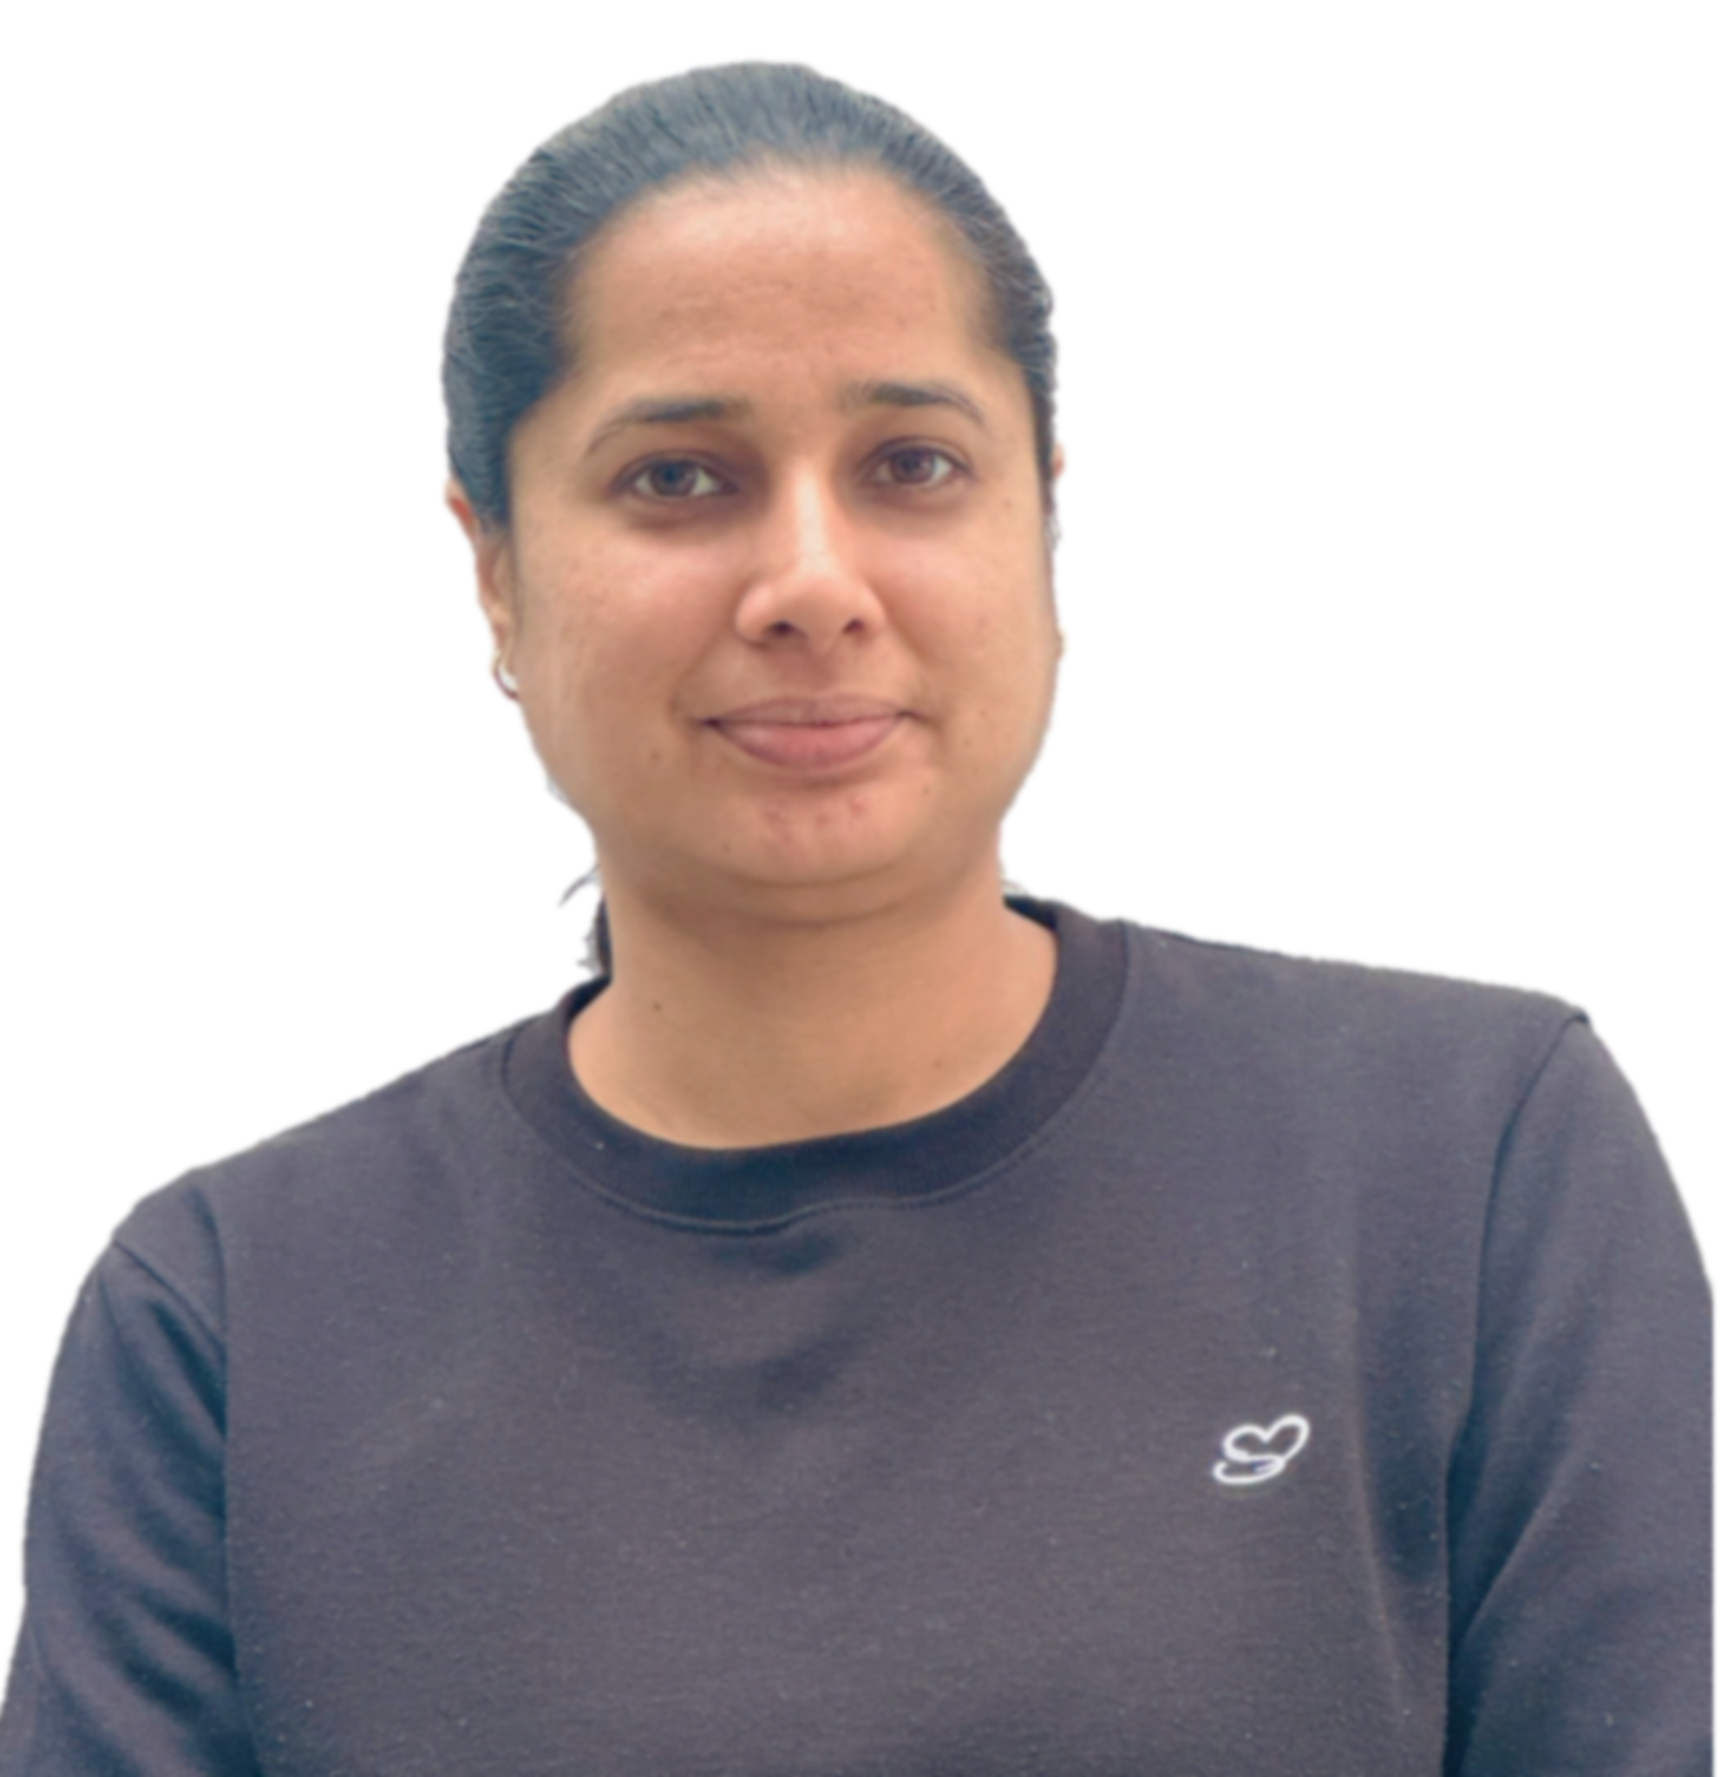
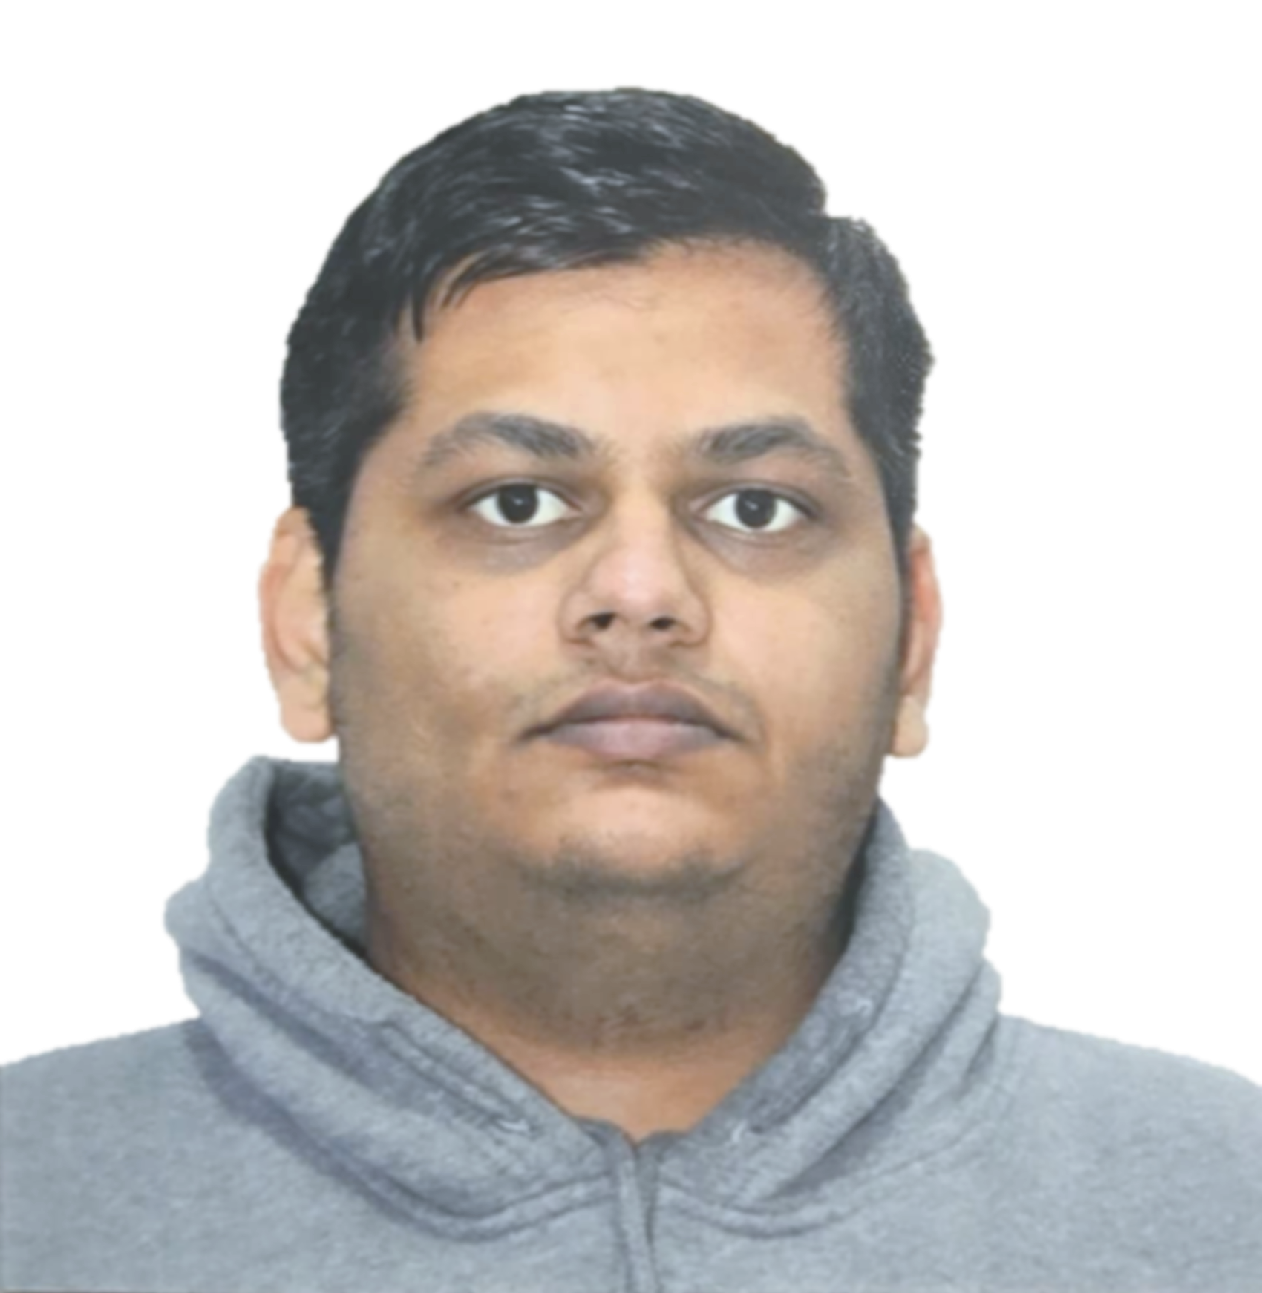
Our team
Gurdeep Singh
Network Security Analyst
Tanishq Jindal
Pratap Shrestha
Network Administrator
Yesh Patel
IoT Technician
Supreet Kaur
Documents and Reporting Lead
Network Administrator
Fenil Surani
Team Lead

Slide 3

about the project
Designing a secure and efficient IoT network architecture for smart buildings, integrating firewalls, VLAN segmentation, intrusion detection systems (IDPS), and centralized monitoring.
Ensuring seamless device connectivity, automated management, and cyber threat mitigation through advanced networking protocols.

Slide 4
PROBLEMS
Security Vulnerabilities
Unauthorized Access
Many IoT devices lack proper encryption and security patches
Hackers gaining access to surveillance cameras.
Performance Issues
Scalability Challenges
Office buildings experience slow internet when too many devices connect.
Expanding IoT networks in buildings leads to difficult device management.

Slide 5
Related incidents
Notes:
This content is taken from Washington Times.

Slide 6
Possible solutions
Firewall & IDPS
VLANs & QoS
Cloud-based Monitoring
UPS
Enhanced Security Measures
Efficient Network Segmentation
Backup Power Systems:
Centralized Monitoring & Automation:
Prevent malware and unauthorized access.
Prioritize critical devices over general traffic.
Ensure uptime during failures.
Real-time network health tracking.

Slide 7
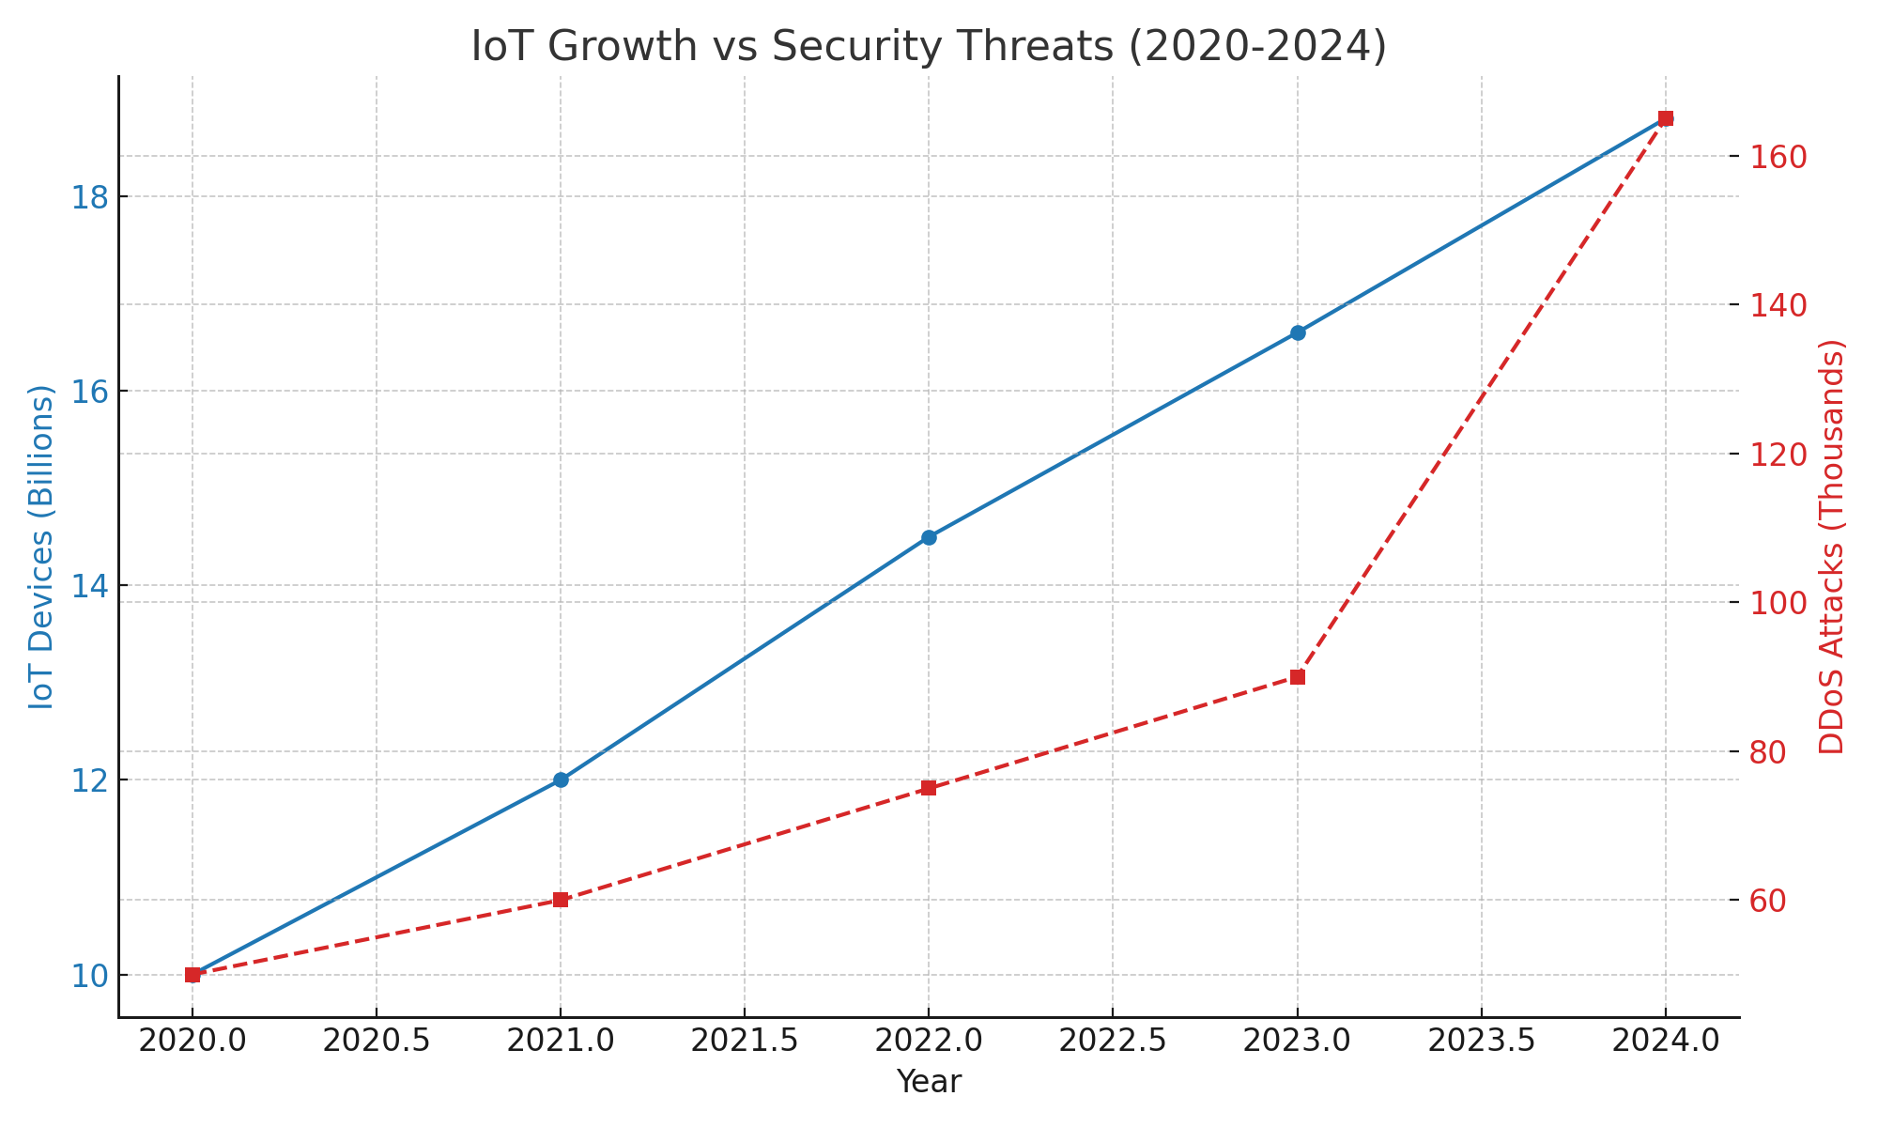

Market trends
Iot Devices
In recent years, the proliferation of Internet of Things (IoT) devices has significantly increased, leading to a corresponding rise in security incidents. In 2024, the number of IoT devices reached 18.8 billion, up from 16.6 billion in 2023.
This rapid expansion has been accompanied by an 82% surge in Distributed Denial of Service (DDoS) attacks, escalating from 90,000 incidents in 2023 to 165,000 in 2024.
Ddos Attacks

Slide 8
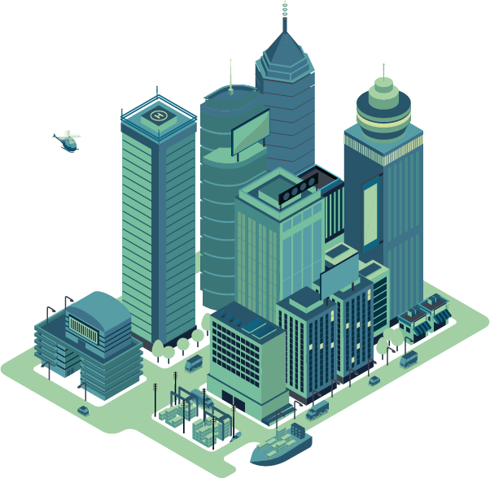
Our VISion
Our vision is to build a secure ecosystem for IoT devices and smart buildings, prioritizing privacy, data integrity, and protection from cyber threats. We aim to provide seamless integration, real-time threat detection, and adaptive solutions, empowering users to safely embrace smart technologies.

Slide 9
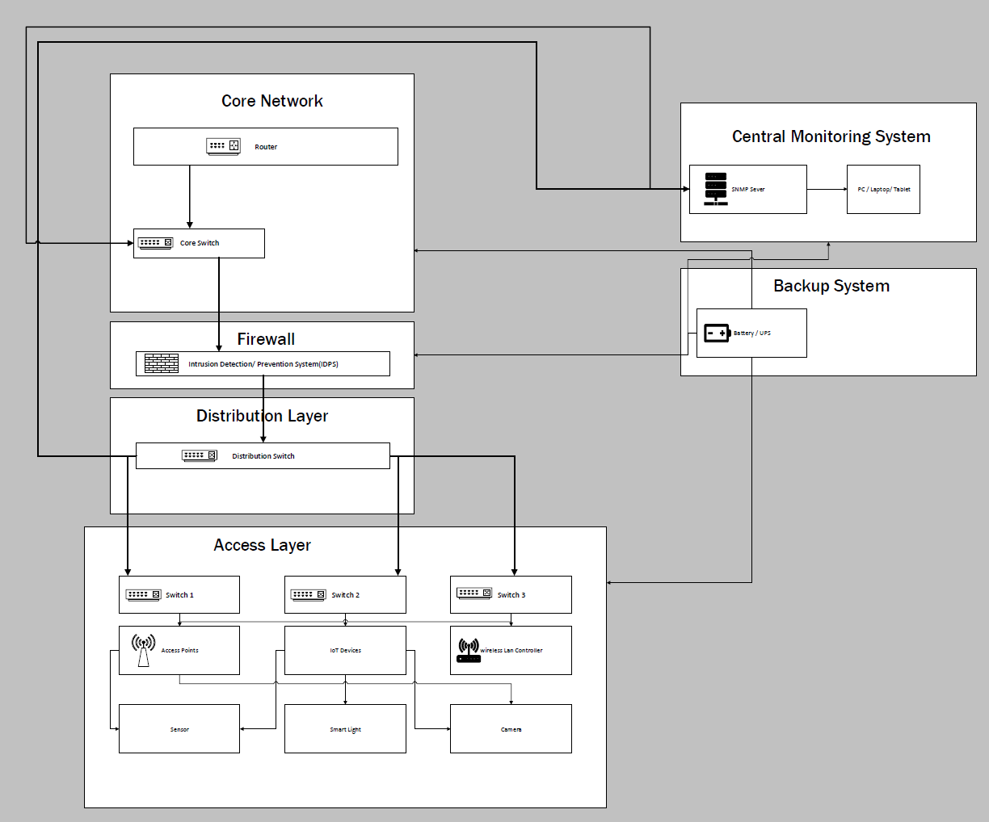

Flow chart
This flowchart represents a secure IoT network architecture for a smart building, ensuring efficient data flow, security, and monitoring. It follows a hierarchical network model with multiple layers, each serving a specific purpose in managing IoT devices, security, and network infrastructure.

Slide 10
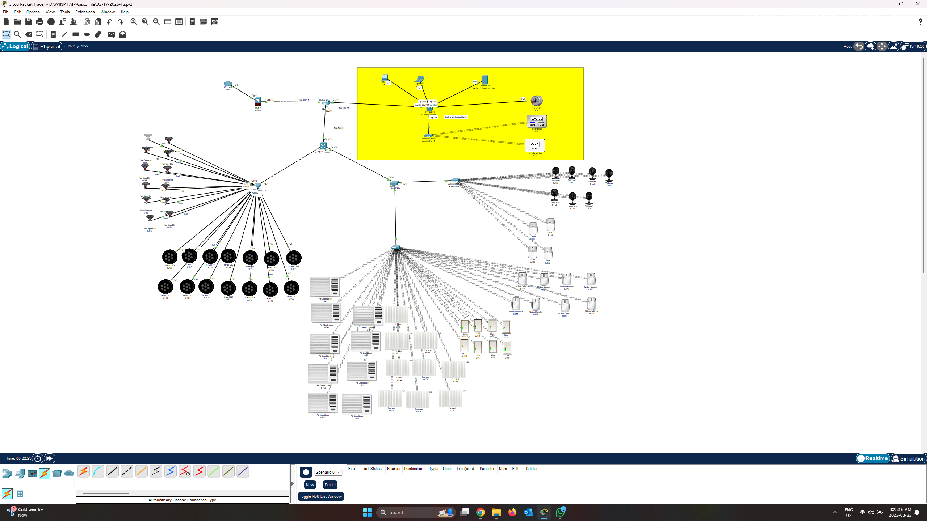
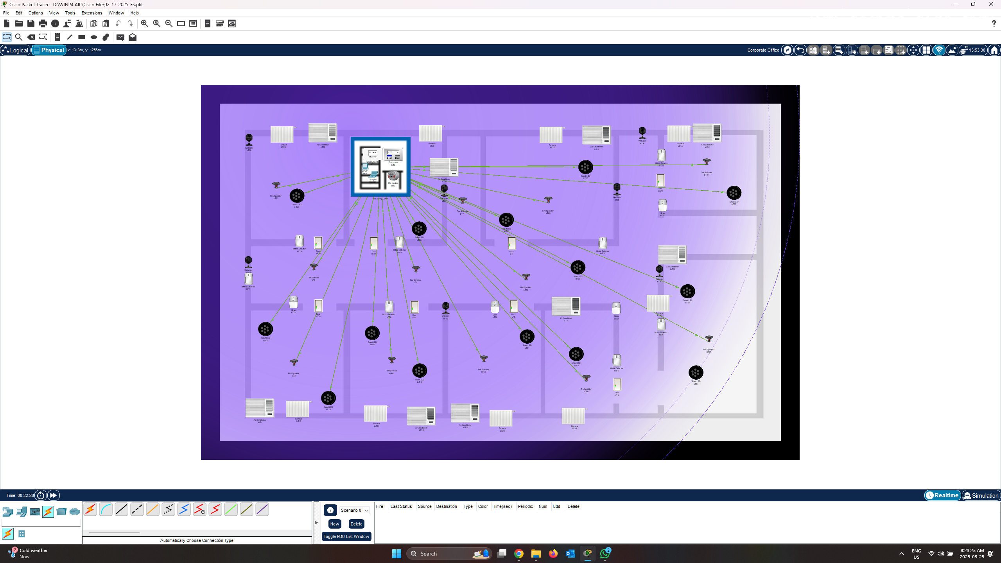
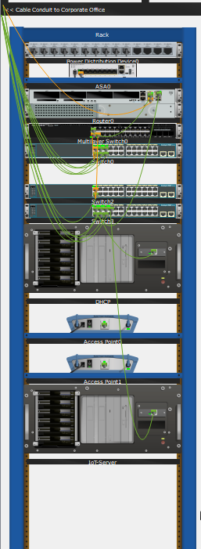
about the project
TOPOLOGY
Logical
Physical
The logical topology refers to how devices and systems are connected and communicate over a network.
The physical arrangement of devices, cables, and network equipment within the smart building infrastructure.

Slide 11
Who Should Adopt Our Solution?
Facility Management & Building Owners: Improve security, reduce costs, and enhance efficiency.
Enterprises & Corporations: Secure critical infrastructure and protect business data.
Government & Public Institutions: Strengthen cybersecurity for smart city initiatives.
Real Estate Developers: Increase property value with advanced IoT security.
Healthcare Facilities & Smart Hospitals: Ensure secure and reliable IoT-based healthcare solutions.

Slide 12
What Others Use vs. Our Edge
Differentiation & Uniqueness
Amazon (AWS IoT Core): Secure but complex → We offer simpler, built-in security.
Google Nest: Great for homes, not scalable → Our design supports enterprise-grade networks.
Cisco Meraki: Powerful but expensive → We deliver similar features at lower cost.
Honeywell: Strong automation, weak on security → We blend both seamlessly.

Slide 13
A secure IoT network is no longer optional—it's essential. Our solution delivers built-in security, real-time threat detection, and scalable architecture tailored for modern smart buildings. By combining cost-efficiency with enterprise-grade protection, we empower organizations to confidently adopt IoT technology while staying secure and future-ready. Smart. Secure. Scalable. That’s our promise.
Conclusion

Slide 14
THANK you
any Questions?

